Slide 1


Accessibility Improvement of China’s Multi-Tier Healthcare Network
A Discrete and Agent Based Simulation Study
By: Jacob Burke
Professor: Xie XiaoLei
September 2019
Thesis Proposal

Slide 2

Introduction: Topic Selection & Significance
Improvement of multi-tier healthcare networks for China’s urban and rural patients.
Through policy and resource allocation recommendations.
By simulating the health care cycles of patients in 1 province (Beijing for now) in a discrete . agent-based model.
With improvement defined as increased accessibility (accessibility defined later).
Recommendations then measured in cost for the payer (insurer).
Examples of recommendations: increase / decrease types of health facilities, change in referral policies, upgrade of curtain facilities capabilities, payment methods & coverage, flow between public and private, stakeholder incentives, staffing levels, etc.
Important because deliver the right care to the right person & decrease the number of patients who need medical attention but cannot / choose not to receive it.
Accessibility Improvement of China’s Multi-Tier Healthcare Network

Slide 3

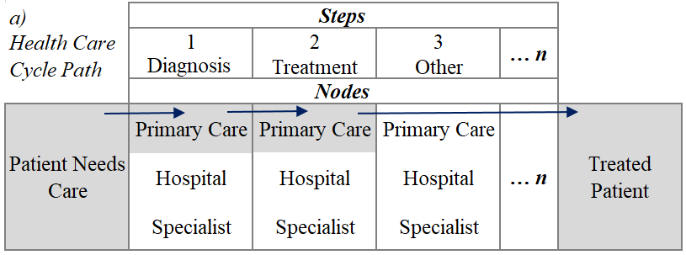
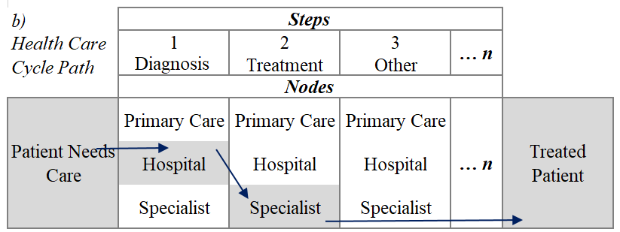
Introduction: Background Information
What’s a health care cycle
Accessibility Improvement of China’s Multi-Tier Healthcare Network

Slide 4

Introduction: Background Information
What’s a Multi-Tier Healthcare Network
A single-tier is single payer. A network where the country offers government funded health insurance to all its citizens despite their ability to pay.
= Universal Only -> Canada, no deductibles
A two-tier network is a health care system which incorporates both public and private funding
= Universal + private -> U.K.,
= Partial Government Insurance + private -> U.S.
Does a single -tier really exist?
Countries with universal health care still have the option for private insurance? Why?
Where does China come in?
Pro’s and Con’s of each.
Accessibility Improvement of China’s Multi-Tier Healthcare Network

Slide 5

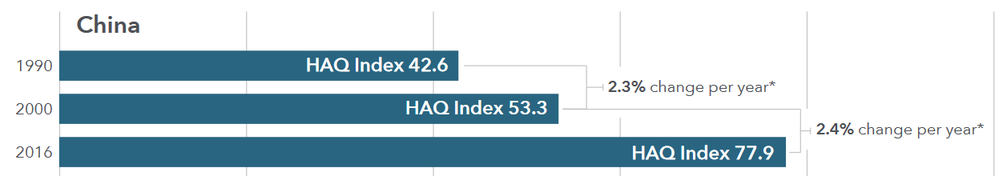
Lit Review: How to Measure Accessibility
Healthcare Access and Quality Index: from 1990 – 2016; focuses on mortality rates of 32 diseases
that should not be killing patients if there is quality access to basic medical care
Service Coverage Index: from 2010 – 2015: Measures 16 health “tracers” including maternal / newborn, reproduction, infectious and non-communicable diseases, service capacity in relation to population, etc. The scale is 0 – 100, and a score of 80 is considered “passing”. China 2015 = 76
Accessibility Improvement of China’s Multi-Tier Healthcare Network

Slide 6
Lit Review: Current Health Care Network Models
Currently, there are very limited models for an entire healthcare network.
My model will combine complex inputs and data points to form a general model.
What can be done is to find unique (previously researched) models for the components of my general model. For example, disease distribution, queue theories, service rates
In addition to hard data such as capacity, staffing levels, capabilities, and more.
Accessibility Improvement of China’s Multi-Tier Healthcare Network

Slide 7
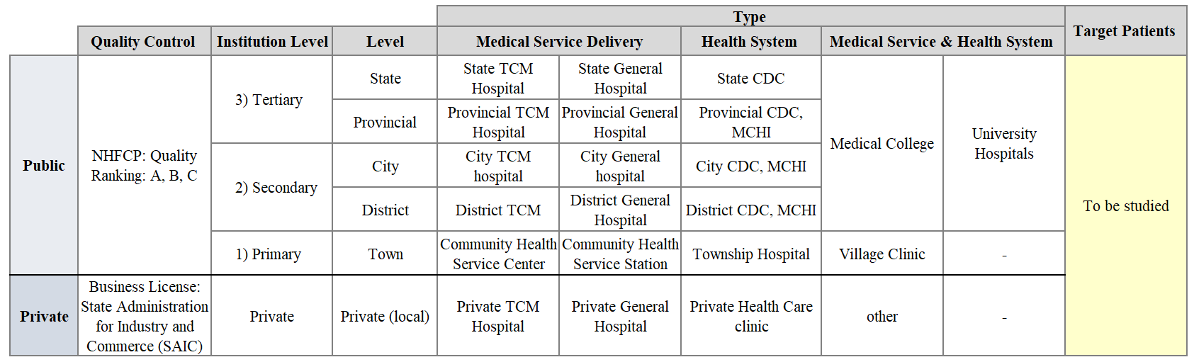
Lit Review: Nodes & Structures
Accessibility Improvement of China’s Multi-Tier Healthcare Network

Slide 8
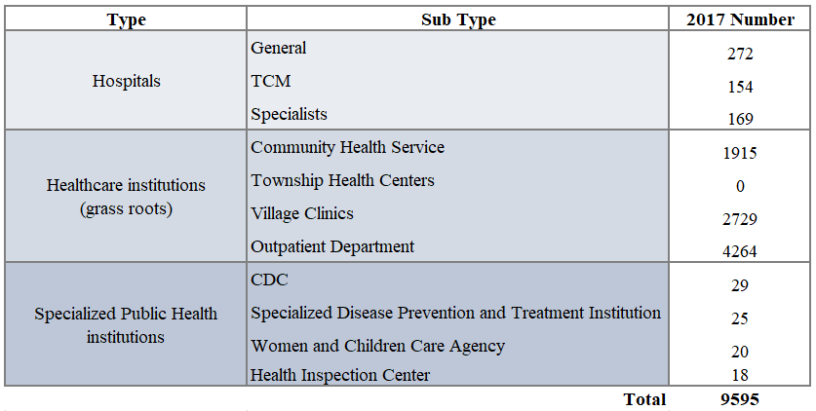
Lit Review: Nodes & Structures
Tertiary | 500 < beds, provide specialist health services, extensive health care, curative treatment, and great emphasis on medical education and research
Secondary | 100 < beds < 500, comprehensive health services, curative treatment some medical education, and research
Primary | beds < 100, minimal equipment, focus on preventative medicine, rehabilitation, and general health care
Quality Ranking | All public institutions at each level ranked "A, B, or C" based on functions, size, technical skills, equipment, and quality of service. "A" in level 3 is the best
Private Health Care | Usually small and limited services. The 48% of all health care facilities employed 17% of all health staff and 9% of beds. Continuing to increase.
Accessibility Improvement of China’s Multi-Tier Healthcare Network

Slide 9
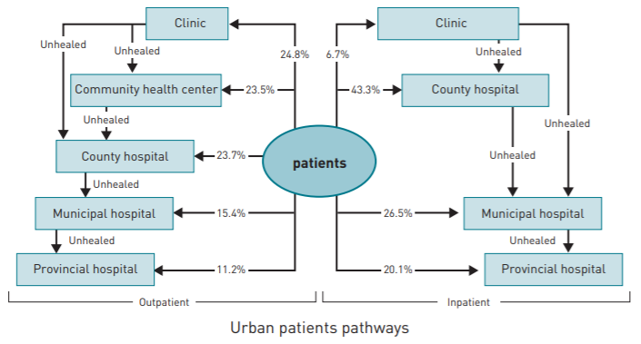
Lit Review: Nodes & Structures
Accessibility Improvement of China’s Multi-Tier Healthcare Network

Slide 10
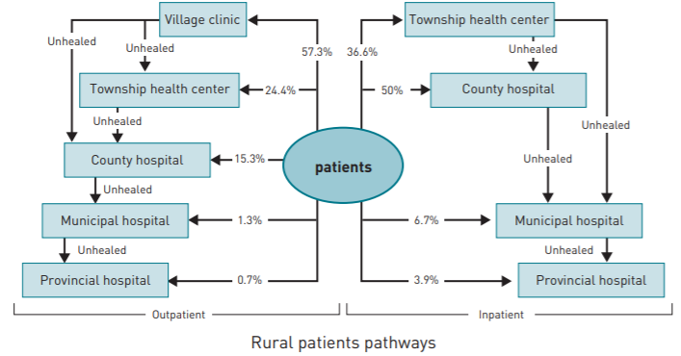
Lit Review: Nodes & Structures
Accessibility Improvement of China’s Multi-Tier Healthcare Network

Slide 11
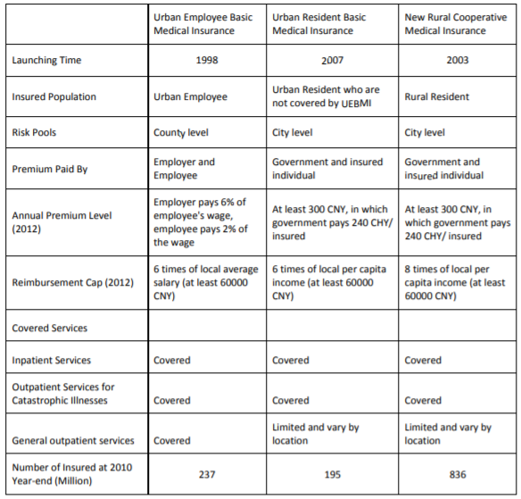
Lit Review: Payment Options - Public
Up Front Payment!
+- 95% Covered!
Emergency Transpo not Covered
No access to Private Facilities
Accessibility Improvement of China’s Multi-Tier Healthcare Network
Notes:
In the U.S., you can usually flow between public and private

Slide 12
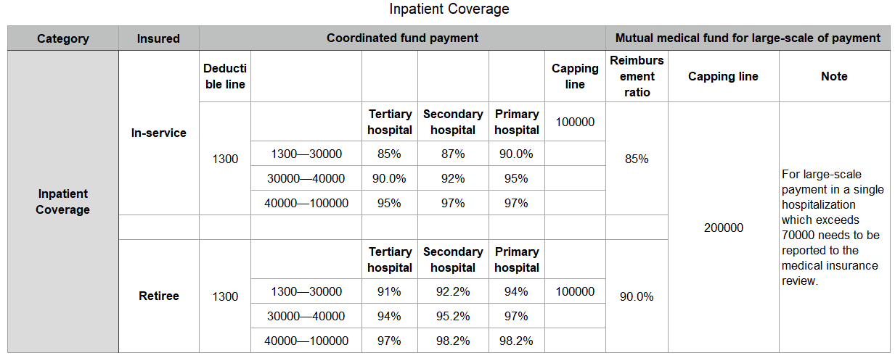
Lit Review: Payment Options - Public
6 X local salary rule: (200,000 / 6 ) / 12 = 2,777 RMB per month
UEBMI
Accessibility Improvement of China’s Multi-Tier Healthcare Network

Slide 13
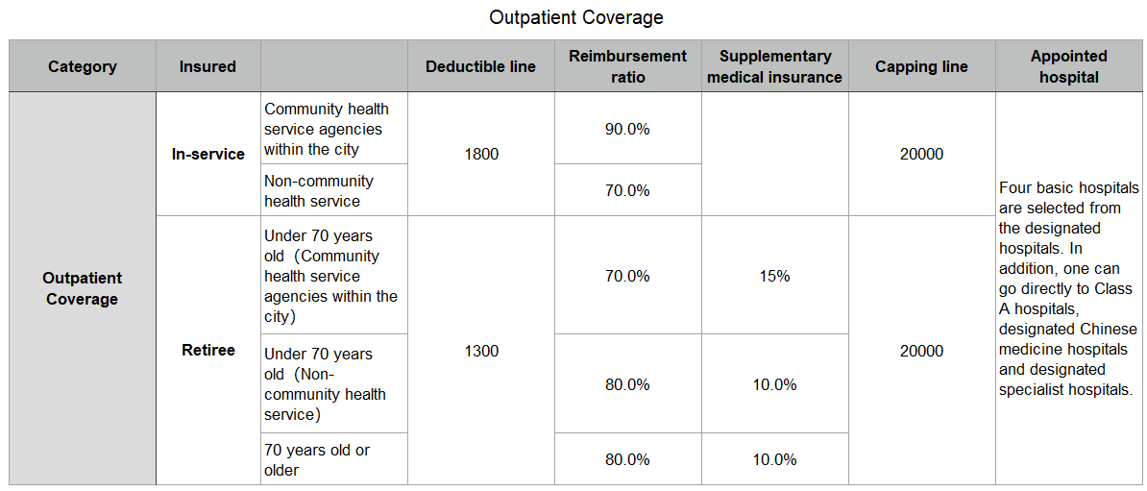
Lit Review: Payment Options - Public
UEBMI
Accessibility Improvement of China’s Multi-Tier Healthcare Network

Slide 14
Lit Review: Payment Options - Private
For public insured patients, you can pay extra for a VIP ward with better room / service.
Government restricts 10% of hospital space used for this purpose.
Do you think the 200,000 RMB cap for medical reimbursement is enough ?
My ACL surgery would have cost around 40,000 RMB. Imagine a Heart Surgery.
Public insurance systems cannot fully cover the costs of catastrophic illnesses, thus the rise of private insurance.
Became available in 1980’s. From 2008 – 2012, the number of private hospitals doubled from 5,400 – 9,800.
Accessibility Improvement of China’s Multi-Tier Healthcare Network

Slide 15
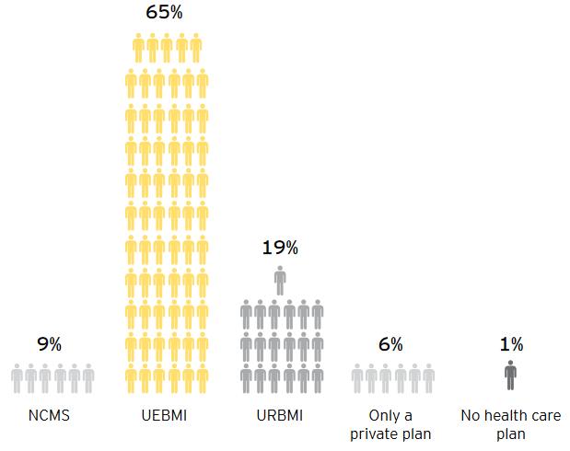
Lit Review: Payment Options - Summary
Accessibility Improvement of China’s Multi-Tier Healthcare Network

Slide 16

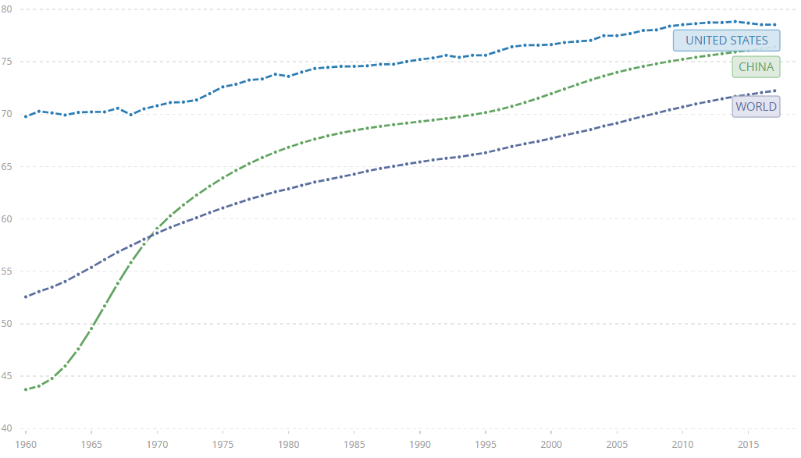
Lit Review: Health Demographics Intro & Main Problems
Accessibility Improvement of China’s Multi-Tier Healthcare Network

Slide 17
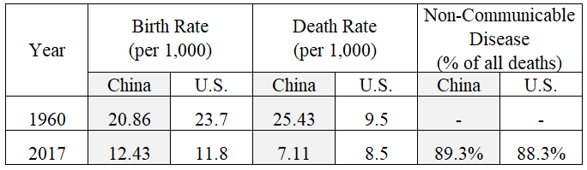
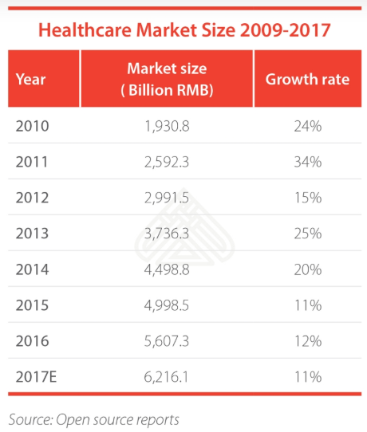
Lit Review: Health Demographics Intro & Main Problems
Aging Population : Retired patients = non-contributing patients.
Inadequate Rural network: Newly insured farmers don’t have comprehensive care, just basic.
Payment upfront : Leads to severe cases of emergency.
Low spending in terms of GDP.
Imbalance of network utilization: Crowded hospitals, no transfer to private
Accessibility Improvement of China’s Multi-Tier Healthcare Network

Slide 18
Lit Review: Health Demographics Intro & Main Problems
“A World Bank study estimates that drugs account for more than 50% of all Chinese health spending, with 12% - 37% of health expenditures wasted because of unnecessary drug prescriptions.”
Doctors are paid low salaries based on hospital revenues -> they push the sale of drugs -> drugs account 40% of hospital budgets -> too much cost passed to patients.
China Health Plan 2030: many reforms to address some of these problems.
2 fapio rule for drugs, increased investment in primary care, better incentives for doctors, etc.
Recommendations CAN align with this plan.
Accessibility Improvement of China’s Multi-Tier Healthcare Network

Slide 19

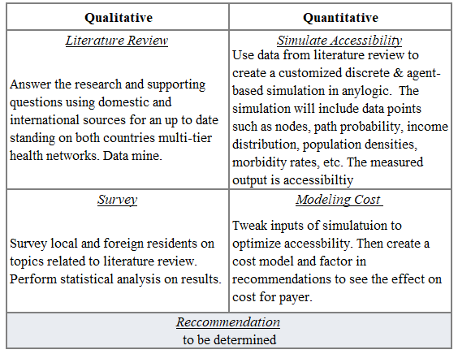
Research Plan & Methodology: Outline
Accessibility Improvement of China’s Multi-Tier Healthcare Network

Slide 20
Research Plan & Methodology: Simulation
Make Assumptions:
If X patient has D disease and N node is capable and available, then they will go depending on: .
X patients have different PC pay capacities (insurance & income)
distributions of D diseases are unique (HAQ index),
P Probability of X patient (rural / urban) going to N node for D disease varies.
Treated = Cured *
Measuring the change in:
Prevalence of diseases measured in HAQ
Number of patients seeking care
Over a prolong simulated time.
Such as until 2030 to align with the China health plan
Build the network for all types of nodes:
Number and types of Nodes with their unique:
Distances, probabilities of correct treatment, service / wait times, baulking probability, technology levels, staffing, capacity, costs, types, flow policies.
Etc.
Accessibility Improvement of China’s Multi-Tier Healthcare Network

Slide 21

Research Plan & Methodology: Simulate health care cycles with
Distributions for HAQ disease, payment plans, & income
Change in HAQ Index
Un-treated Population
Treated Population
Referral Rates
Probability per urban / rural
Treated Referred
Enter new
Node N
Baulk
Que theory
Enter Node N
Wait
Service
Treated Sink
Repeat Node Process
Node Process
Based on Capacity, technology, and other researched models.
Probabilities of single step visit
Accessibility Improvement of China’s Multi-Tier Healthcare Network

Slide 22
Research Plan & Methodology: Modeling recommendations into cost
To be determined
Accessibility Improvement of China’s Multi-Tier Healthcare Network

Slide 23

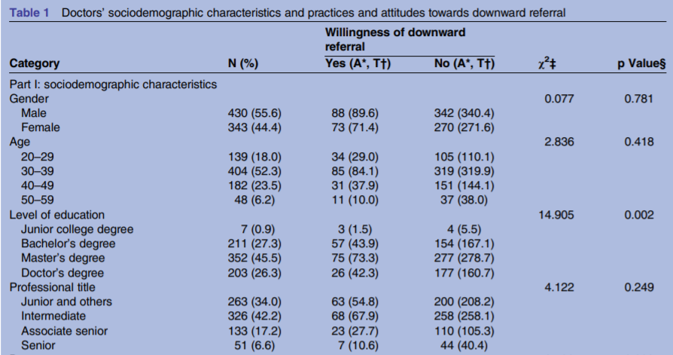
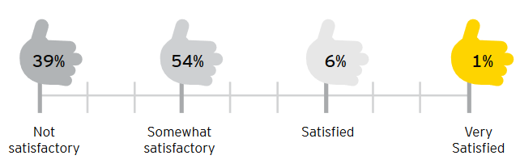
Other: Extra Literature Review & Survey
Governing bodies and specific health laws.
Complete Stakeholder analysis (why high drug costs? Why low doctor pay?)
Online health care
Survey to gauge perception and trends.
Exact distribution trends of the measured diseases.
And more…
Accessibility Improvement of China’s Multi-Tier Healthcare Network

Slide 24

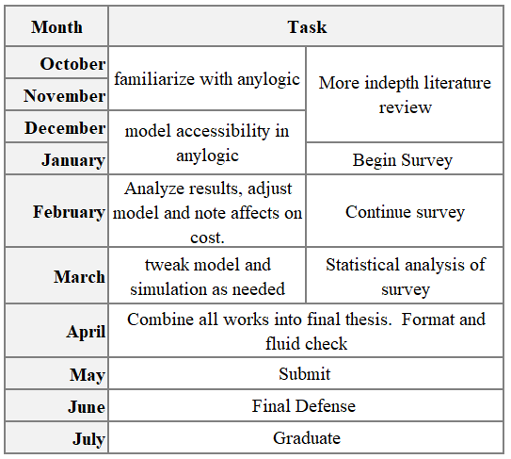
Thesis Schedule
Accessibility Improvement of China’s Multi-Tier Healthcare Network

Slide 25

Works Cited
Amadeo, K. (2019, June 25). https://www.thebalance.com/universal-health-care-4156211. Retrieved September 5, 2019
Anylogic. (n.d.).
China, N. B. (2017). Health Care Institutions. Beijing: China Statistics Press.
ChinaDaily. (2019, 7 10). http://www.chinadaily.com.cn/a/201907/10/WS5d25ab16a3105895c2e7cc5b.html. Retrieved 9 11, 2019
Daniel R Hogan, P. G. (2017). Monitoring universal health coverage within the Sustainable Development Goals: development and baseline data for an index of essential health services. The Lanet, 152-168.
Dezan Shira, Q. Z. (2018, 2 19). China’s Healthcare Reforms Underscore Market Growth. Retrieved from China Briefing: https://www.china-briefing.com/news/healthcare-reforms-underscore-market-growth-china/
Hai Fang, P. U. (n.d.). Common Wealth Fund . Retrieved 9 20, 2019
Henu Zhao. ( 2019, September 17). China's Health Insurance Reform and Disparities in Healthcare Utilization and Costs: A Longitudinal Analysis, Santa Monica, Calif.: RAND Corporation, RGSD-345, 2015. Retrieved September 20, 2019, from https://www.rand.org/pubs/rgs_dissertations/RGSD345.html.
Husain, S. (2019, 8 15). https://www.livestories.com/blog/morbidity-vs-mortality-rate. Retrieved 9 11, 2019
Internations.org. (2019, 5 27). https://www.internations.org/go/moving-to-china/healthcare. Retrieved 9 20, 2019
Internations.org. (2019, March 26). https://www.internations.org/go/moving-to-the-uk/healthcare/private-health-insurance-in-the-uk. Retrieved September 5, 2019
Jonathan Zhao, A. N. (n.d.). The rise of private health insurance in China | Consumer demand presents huge opportunities and risks. Retrieved from ey.com: https://www.ey.com/Publication/vwLUAssets/EY-the-rise-of-private-health-insurance-in-china/$FILE/EY-the-rise-of-private-health-insurance-in-china.pdf
Ke Xu, P. S. (2009). Health care financing in rural China: new Rural Cooperative Medical Scheme. Retrieved from WHO: https://www.who.int/health_financing/documents/pb_e_09_03-china_nrcms.pdf?ua=1
Lipton, W. (2012, August 30). https://www.physicianspractice.com/two-tiers-america-has-multi-tiered-healthcare-now. Retrieved September 5, 2019
Meng, Q., Yang, H., Chen, W., Sun, Q., & Liu, X. (2015). People's Republic of China Health System Review. Retrieved 9 10, 2019, from http://apps.searo.who.int/PDS_DOCS/B5413.pdf.
Nancy De Lew, G. G. (1992). A layman's guide to the U.S. health care system. PubMed Central, 151-169. Retrieved 9 12, 2019
National Bureau of Statistics China. (n.d.). http://www.stats.gov.cn/tjsj/ndsj/2018/indexeh.htm. Retrieved 9 12, 2019
Nofri, E. M. (2015, 11 15). http://www.albertoforchielli.com/the-chinese-healthcare-system-how-it-works-and-future-trends/. Retrieved 9 20, 2019
Population Reference Bureau. (2009, 7 1). https://www.prb.org/humanpopulation/. Retrieved 9 11, 2019
Services, I. o., & Millman M, e. (1993). Access to Healthcare in America. NCBI.
Svetlana Doubova, R. P.-C. (2018). Going further to measure improvements in health-care access and quality. The Lancet, 2190-2192.
University of Pennsylvania. (2016, 1 25). https://budgetmodel.wharton.upenn.edu/issues/2016/1/25/mortality-in-the-united-states-past-present-and-future. Retrieved 9 22, 2019
Wee, S.-L. (2018, 9 30). https://www.nytimes.com/2018/09/30/business/china-health-care-doctors.html. Retrieved 9 16, 2019
Wenya Yu1, M. L. (2017). Practices and attitudes of doctors and patients to downward referral in Shanghai, China. BMJ.
WHO, Lucy Gilson. (2012). https://www.who.int/alliance-hpsr/resources/publications/9789241503136/en/. Retrieved September 3rd, 2019
World Bank. (2019). https://data.worldbank.org/indicator/SP.DYN.LE00.IN?end=2017&locations=US-CN-1W&start=1960&view=chart. Retrieved 9 10, 2019
Yu, W., Li, M., Ge, Y., Li, L., Zhang, Y., Liu, Y., & Zhang, L. (2015). Transformation of potential medical demand in China: A system dynamics simulation model. Journal of Biomedical Informatics, 399-414.
Yuelian Sun, H. G. (2017). Chinese health care system and clinical epidemiology. PubMed Central, 167-178.
Zheng Yiran, C. D. (2018, 9 21). http://www.chinadaily.com.cn/a/201809/21/WS5ba456e5a310c4cc775e780e.html. Retrieved 9 16, 2019
Accessibility Improvement of China’s Multi-Tier Healthcare Network

Slide 26
Questions
Accessibility Improvement of China’s Multi-Tier Healthcare Network

